Slide 1
TYPOGRAPHY

Slide 2
INTRODUCTION to TYPOGRAPHY

Slide 3
TYPOGRAPHY
Type, or text, refers to the words that appear on maps
Typography is the art or process of specifying, arranging, and designing type
Well-designed type can make a map easier to understand and more attractive

Slide 4
TYPOGRAPHY
Several map elements are composed partly of type, and others are composed entirely of type
  Type can be considered a special symbol, or even a map element in its own right
Type plays in indispensable role in cartography
  But is often taken for granted, or treated as an afterthought

Slide 5
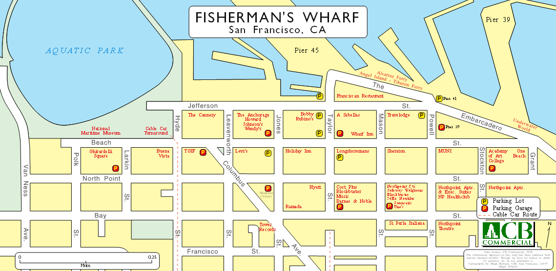

TYPOGRAPHY
The integral role of type
Graphics and Type

Slide 6
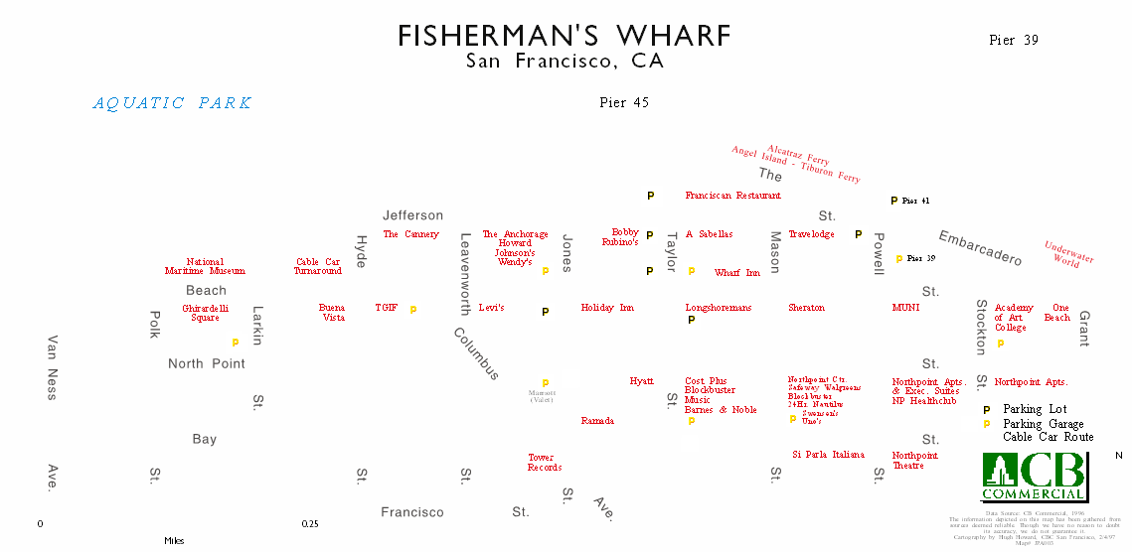
TYPOGRAPHY
The integral role of type
Type Only

Slide 7
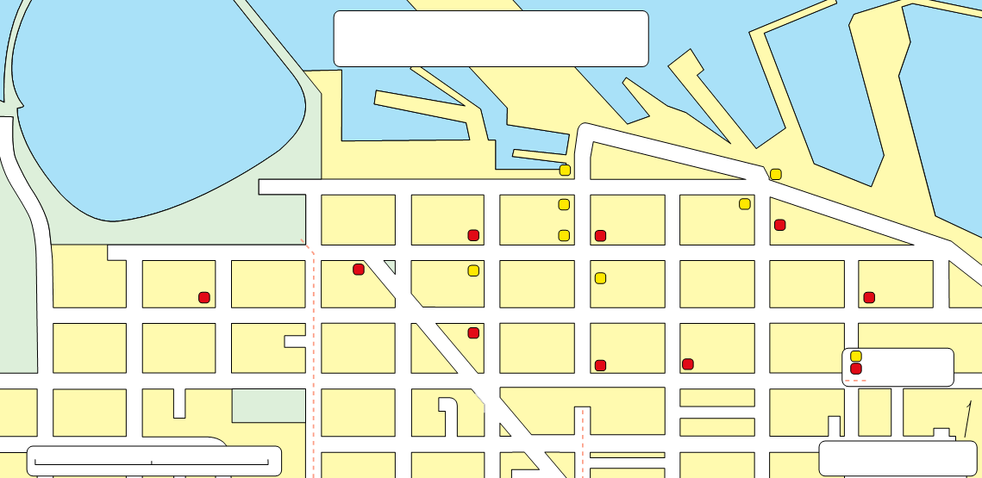
TYPOGRAPHY
The integral role of type (cont.)
Graphics Only

Slide 8
TYPOGRAPHY
The rules and guidelines for the use of type in cartography are derived from general rules of typography
  But have been modified over time to reflect the specific purposes of mapmaking
  Fortunately, these rules and guidelines are relatively well defined

Slide 9
TYPOGRAPHY
Build a foundation of typographic skills by following the specific rules and guidelines presented here
  Consider alternative approaches once you master these rules and guidelines
  Always be prepared to explain or defend your typographical decisions

Slide 10
CHARACTERISTICS of TYPE

Slide 11
CHARACTERISTICS
Type is commonly organized according to the following characteristics
  Type Family
  Type Style
  Typeface
  Type Size
Additional terms include
  Font

Slide 12
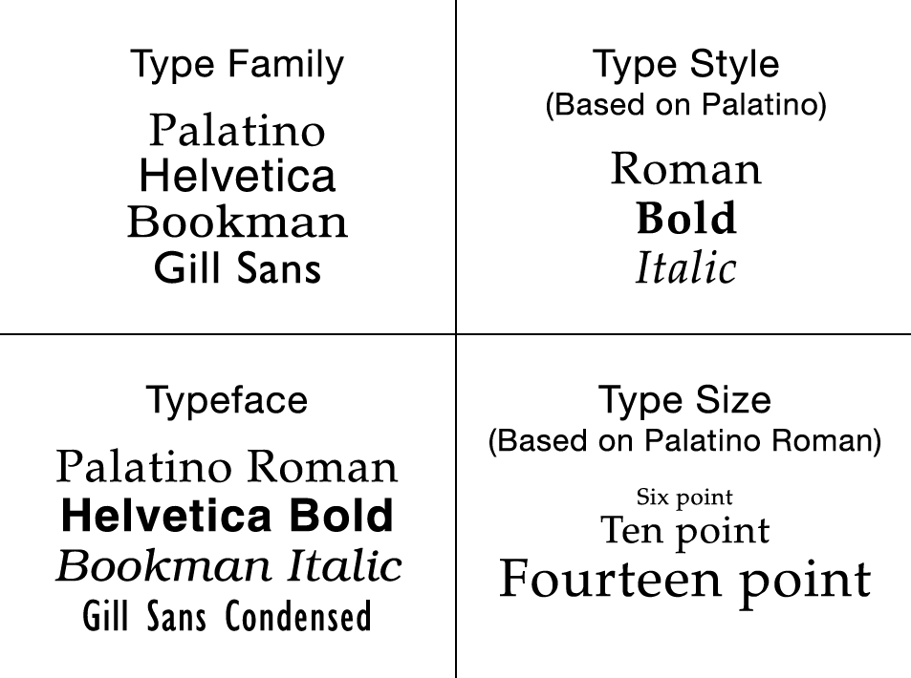
CHARACTERISTICS

Slide 13
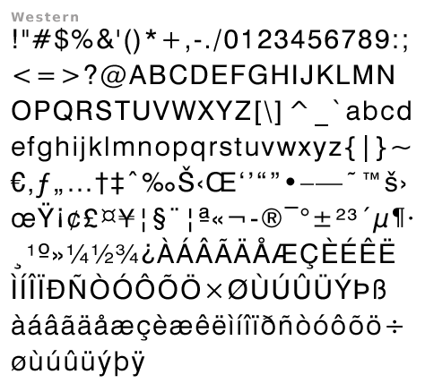
CHARACTERISTICS
A Font
  Is a set of all alphanumeric and special characters of a particular type family, type style, and type size
Helvetica
Roman
14 point

Slide 14
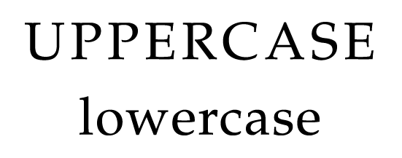
CHARACTERISTICS
Uppercase and lowercase letters are used in cartography, but lowercase have proven to be easier to read
  Lowercase letters are less blocky, and provide more detail that helps differentiate one letter from another

Slide 15
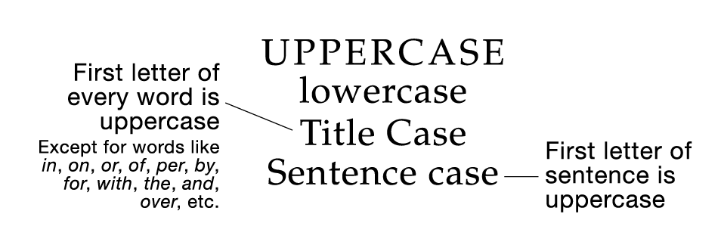
CHARACTERISTICS
The majority of type on a map should be set in Title Case
  Title Case is appropriate for use in titles, subtitles, legend headings, legend definitions, labels for point and line features, and so on

Slide 16
CHARACTERISTICS
Sentence case is appropriate when formal sentences are used
  Sentence case can be used for textual explanations or descriptions appearing on a map

Slide 17
CHARACTERISTICS
Words set in all UPPERCASE
  Are appropriate as labels for areal features
  Are sometimes used as short titles

Slide 18
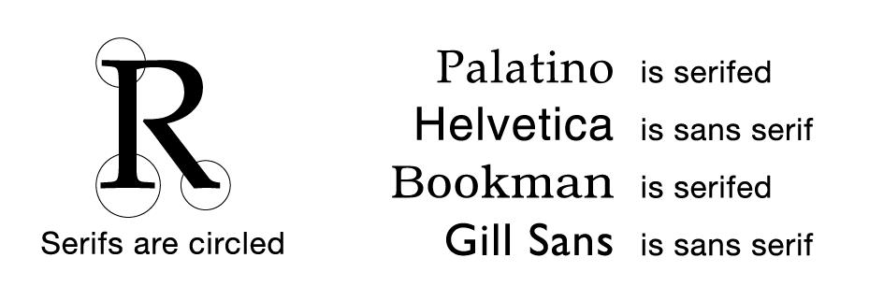
CHARACTERISTICS
Serifs are short extensions at the ends of major letter strokes
  Type families with serifs are termed serifed; type families without are sans serif (without serifs)

Slide 19
CHARACTERISTICS
Serifed type is preferred in the context of written documents
  Neither has proven to be more effective on maps
  Both are used in cartography
In certain situations, both can be used
  A serifed family can be used for one category of features (e.g., natural)
  A sans serif family can be used for another category (e.g., cultural)

Slide 20
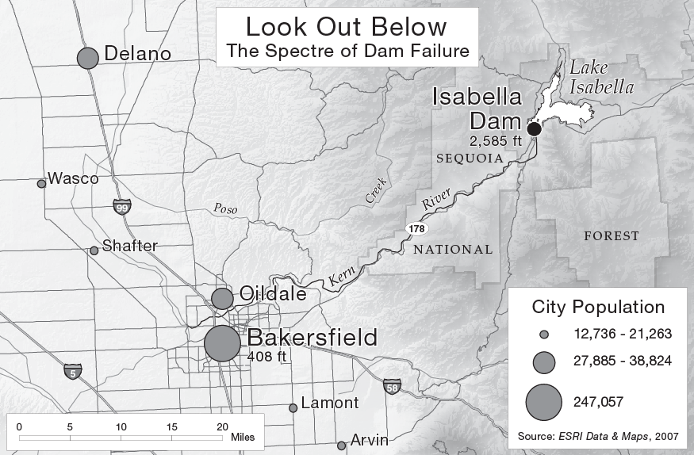
CHARACTERISTICS

Slide 21
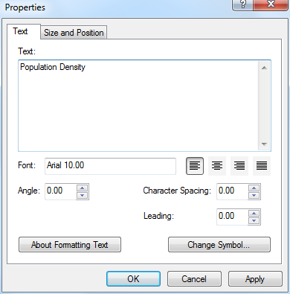
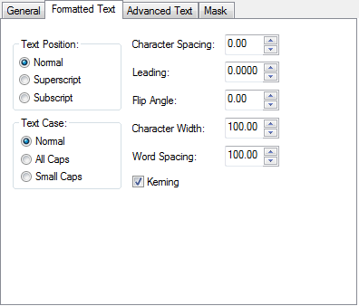
CHARACTERISTICS
Letter Spacing (Character Spacing) is the space between letters in a word
Word Spacing is the space between words

Slide 22
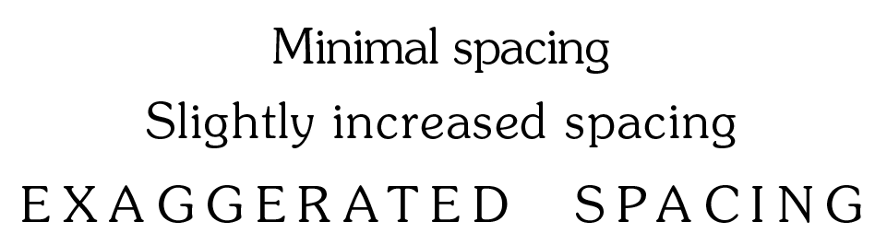
CHARACTERISTICS
Minimal letter and word spacing
  Results in compact type that is often easier to place on complex maps
Slightly increased spacing
  Results in type that appears to be less “cramped” and is easier to read
  Employ slightly increased spacing

Slide 23
CHARACTERISTICS
Exaggerated letter and word spacing
  Is often used in conjunction with all-uppercase type when labeling areal features
  The blocky nature of all-uppercase type normally requires greater letter and word spacing than lowercase type

Slide 24
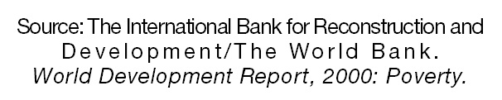
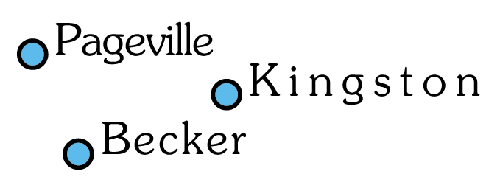
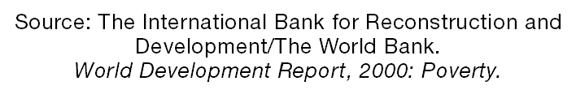
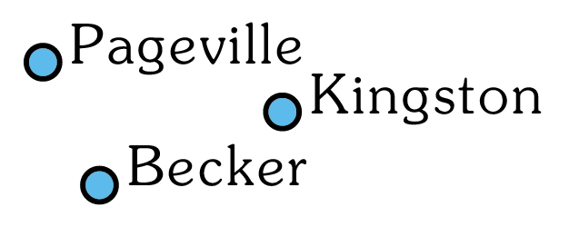
CHARACTERISTICS
Letter and word spacing should be kept consistent
  Within individual blocks of type
  Among labels that are otherwise similar
Inappropriate
Appropriate

Slide 25
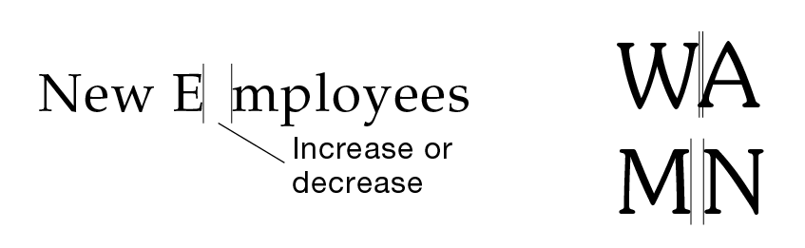
CHARACTERISTICS
Kerning refers to the variation of space between two adjacent letters
  Different combinations of adjacent letters require different amounts of kerning to be visually consistent

Slide 26
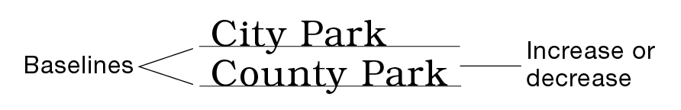
CHARACTERISTICS
Leading, or line spacing, refers to the vertical space between lines of type according to their baselines
  Leading should be great enough to allow multiple lines of type to be read easily, without wasted space between lines

Slide 27
GENERAL TYPOGRAPHIC GUIDELINES

Slide 28
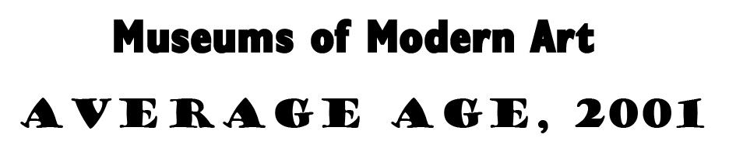
GENERAL GUIDELINES
Avoid the use of decorative type families, and use bold styles sparingly
  Script, cursive, and otherwise fancy styles are unnecessarily difficult to read
  The overuse of bold can overshadow other type and map elements; it is often unnecessary with appropriately sized type
Bold and Decorative Type

Slide 29

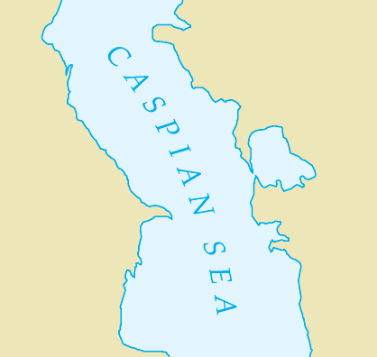
GENERAL GUIDELINES
If possible, italic type should be reserved for specific applications
  To label hydrographic (water) features
Italics are appropriate for hydrographic features because their slanted form resembles the flow of water

Slide 30
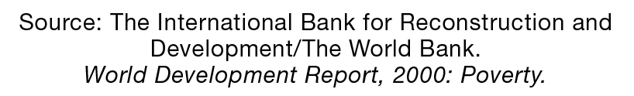
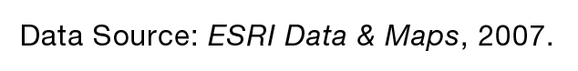
GENERAL GUIDELINES
If possible, italic type should be reserved for specific applications
  To identify publications in the data source (publications only!)
The use of italics for publications is standard bibliographic practice

Slide 31
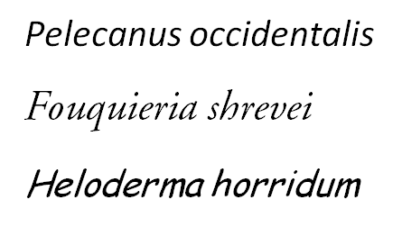
GENERAL GUIDELINES
If possible, italic type should be reserved for specific applications
  To identify the species of an organism
By convention, the first word (genus) is capitalized

Slide 32
GENERAL GUIDELINES
Avoid using more than two type families on a given map
  Simpler maps can be limited to one
  For consistency, all map elements should employ the same type family
  If two type families are required, choose families that are distinctly different—one serifed and one sans serif, for example

Slide 33
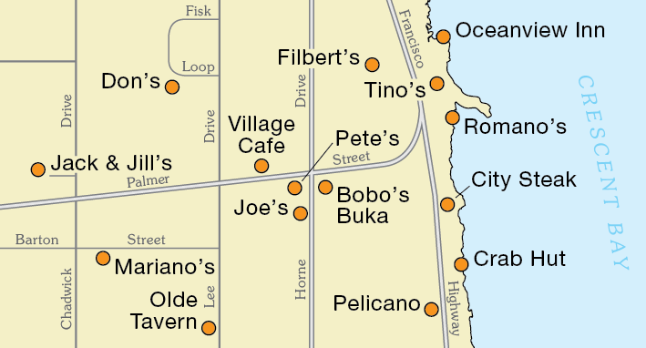
GENERAL GUIDELINES
Natural vs. Cultural
Thematic Symbols vs. Base Information

Slide 34

GENERAL GUIDELINES
Choose a realistic lower limit for size
  All type needs to be readable by the intended audience
  Factors include the map user’s age, proximity to the map, map reproduction method, anticipated lighting conditions…
  If possible, provide a sample to members of the intended audience

Slide 35
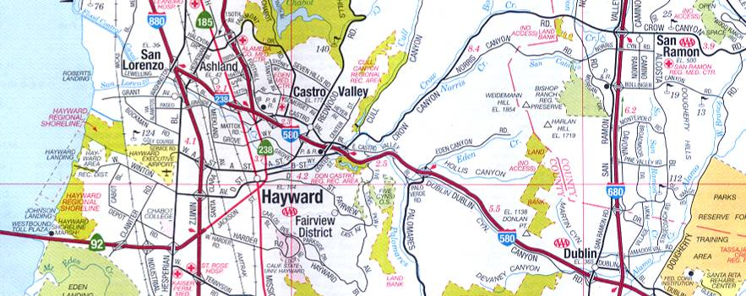
GENERAL GUIDELINES
Type size should correspond with the relative sizes of features
  For example, type representing large cities should be noticeably larger than type representing small cities

Slide 36
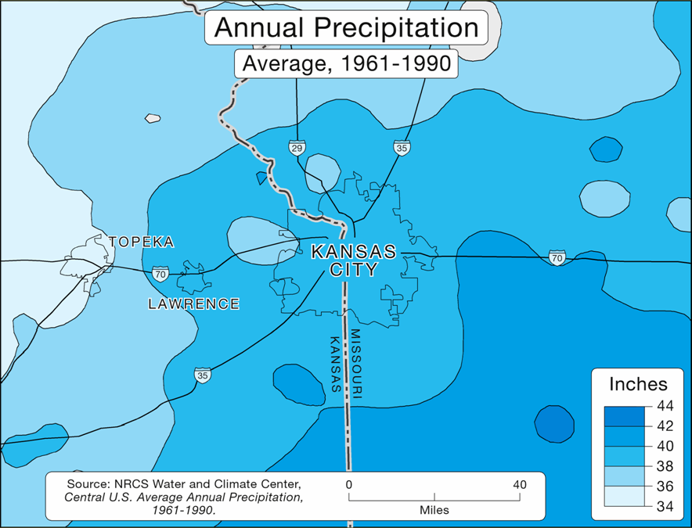
GENERAL GUIDELINES
Type size should correspond with the relative importance of map elements
  Type associated with more important map elements should be larger
Avoid size differences of less than two points if possible

Slide 37
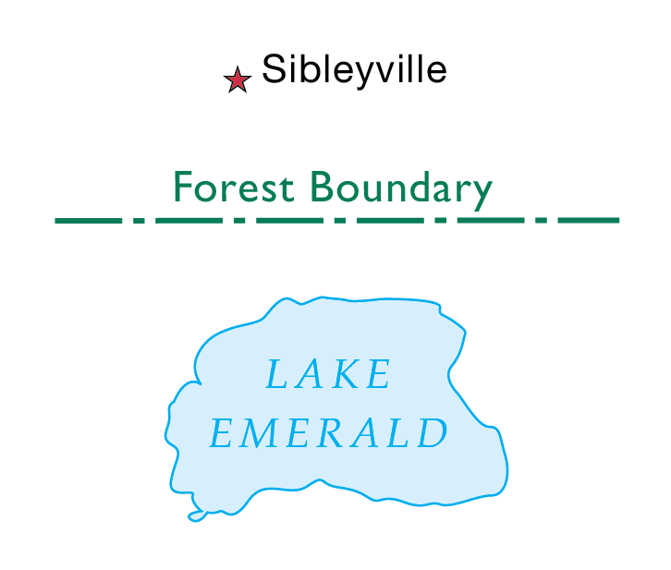
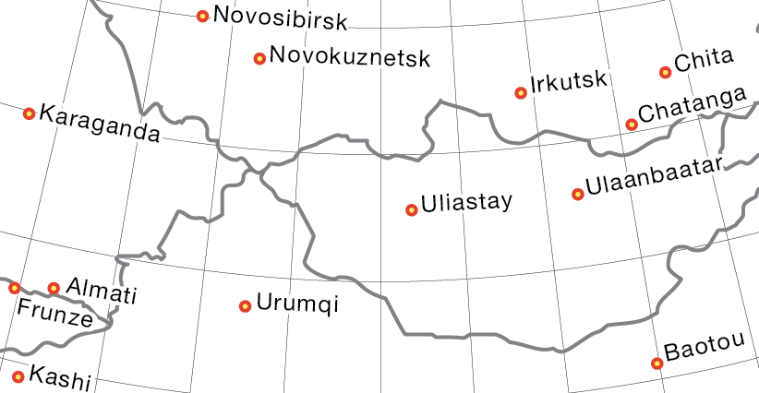
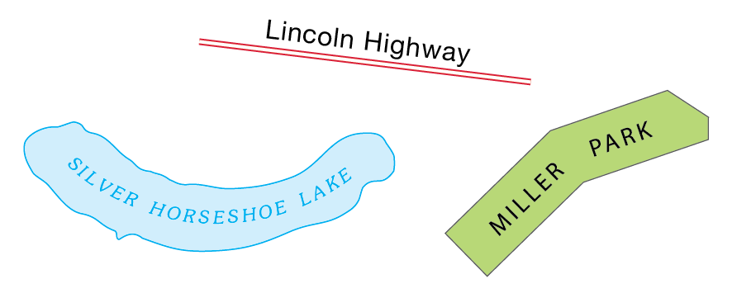
GENERAL GUIDELINES
Orient type horizontally
  Except when labeling diagonal or curved features, in which case the type should reflect the orientation of the features

Slide 38
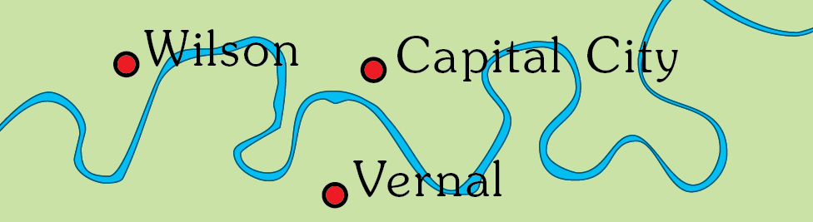
GENERAL GUIDELINES
Avoid overprinting and, when necessary, minimize its effects
  Overprinting occurs when type is placed on top of a map feature, obscuring the type and making it difficult to read

Slide 39
GENERAL GUIDELINES
The effects of overprinting can be minimized through the use of
  Masks
  Halos
  Callouts

Slide 40
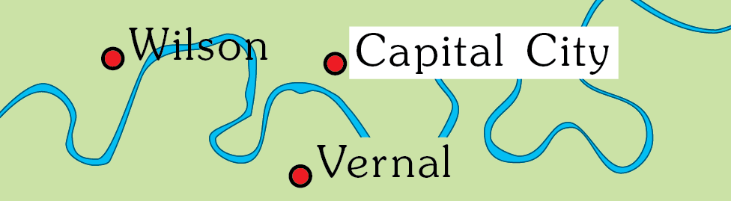
GENERAL GUIDELINES
A mask is a polygon placed below type, but above the mapped area
  Masks can sometimes obscure too much of the mapped area
  Masks can be specified with the same color as the underlying area

Slide 41
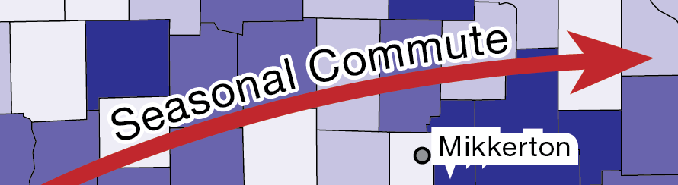
GENERAL GUIDELINES
A halo is an extended outline of letters
  Haloes cover less of the underlying mapped area than masks, while still allowing the type to be read
  Don’t make haloes so thick that they attract undue attention

Slide 42
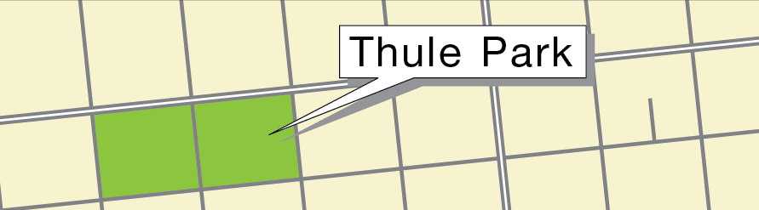
GENERAL GUIDELINES
Callouts are a combination of mask and leader line
  Callouts are effective, but should be used with caution
  They are visually dominant and can overshadow other map elements

Slide 43
GENERAL GUIDELINES
Critically evaluate and apply type specifications
  Do not passively accept the default settings provided by software applications
  Instead, consider the purpose of each unit of type in the context of the map, and apply type specifications accordingly

Slide 44
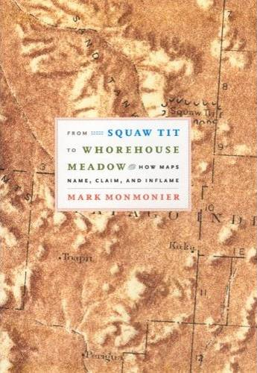
GENERAL GUIDELINES
All type should be spell-checked
  Spelling errors interfere with cartographic communication, and undermine the credibility of a map
Beware of older place names
  Many are considered to be offensive or derogatory by today’s standards

Slide 45


